Slide 1
Clustering in R
Submitted by: mansi

Slide 2
Case Study 2- Predicting Stock Returns
Objective: To use clustering to identify clusters of stocks that have similar returns over time using the Stock Returns Data.
Business Problem: To predict whether or not the stock return in December will be positive, using the stock returns for the first 11 months of the year because when selecting which stocks to invest in, investors seek to obtain good future returns.

Slide 3
About the Data
Each data point in the dataset is the monthly returns of a particular company in a particular year from 2000 to 2009. The companies are limited to tickers whose stock price never fell below $1.
PositiveDec represents whether or not the company's stock had a positive return in December (in the year of the observation). This variable takes value 1 if the return was positive, and value 0 if the return was not positive.
Jan | Feb | March | April | May | June | July | August | Sep | Oct | Nov | PositiveDec
The return for the company's stock during the month (in the year of the observation) |  |  |  |  |  |  |  |  |  |  | 0/1

Slide 4
Visualization
It is important to note here that positive returns are more than 50% whereas negative returns denoted by 0 are less than 50%. This is the target variable if we go for prediction. The line diagram shows the returns of a particular company for a particular year of observation.

Slide 5
Fluctuations!
What else did you expect from stock returns data?
This is the plot column chart for all the data points all through the years i.e. the line graph in the previous slide multiplied by 11580.

Slide 6
Methodology
We first check our data for missing values. Then we perform logistic regression on it for predicting the Positive December returns. The logreg model is then checked for its efficiency and power using various tests.
Then the data is clustered using two different techniques namely Hierarchical clustering and K means clustering. Optimum number of clusters are found that best suit our data.

Slide 7
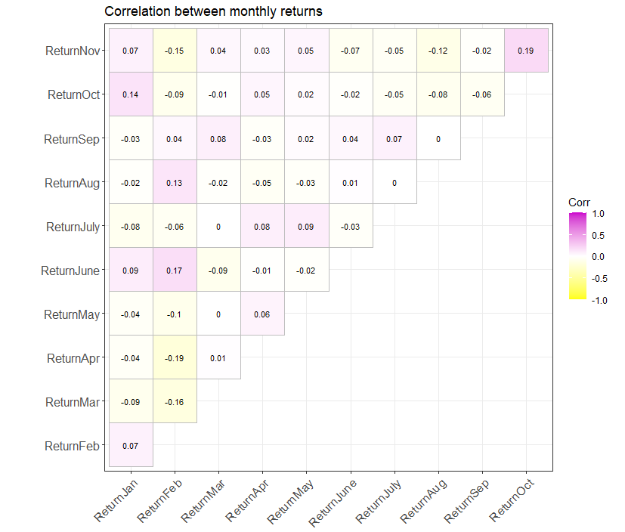
Correlation
This plot between months shows how every individual month is corelated to every other month from January to November. The highest correlation is observed to be 0.19 which is between Returns in November and Returns of October.

Slide 8
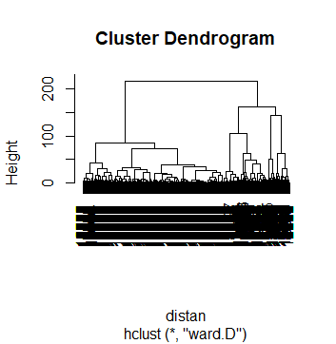
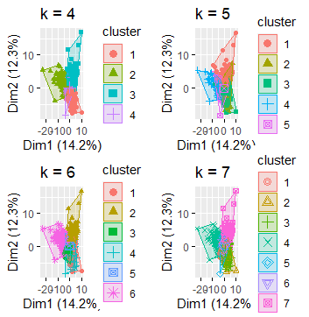
Hierarchical Clustering
We obtain this dendrogram from which we can visually assess roughly the number of clusters that will suit our data. Along with that we have cluster distribution diagram for different number of clusters that can help us guess the number of optimum clusters.

Slide 9
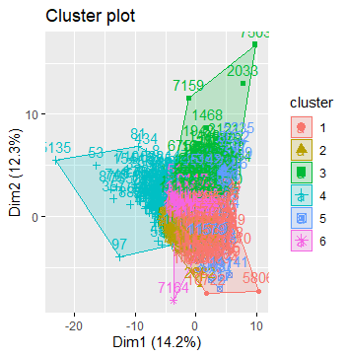
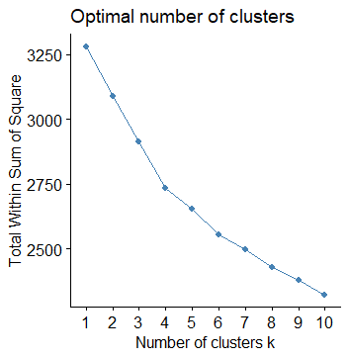

K Means Clustering
Using this technique, we provide the k value i.e. number of clusters and then compare the centred means of the clusters. For final decision of k, we utilize the elbow method(top right plot.) Finally, with 6 clusters we get our data distributed.

Slide 10
Interpretations
From the logistic regression model, we conclude that the returns of March and August do not affect the outcome of December within 90% confidence level.
The KS statistics value come out to be 0.129 which is greater than 0.05. This implies that we have obtained normality (normal distribution.) Thus, better prediction.
On clustering, we end up making 6 clusters for 11580 observations with a fair amount of distribution in each cluster.
Having 6 clusters will surely lead to more efficient data management.

